Slide 1
Group 4: Peak Finders
Rory, Vlad, Tejas, Heidi and Jonah
RAL Visitor Centre
07.07.23

Slide 2
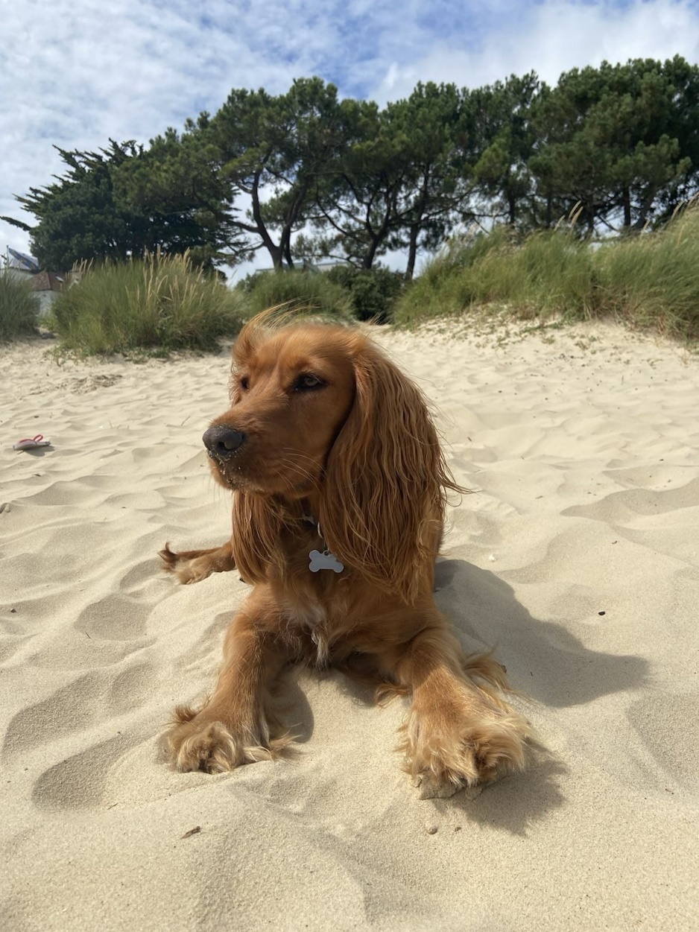
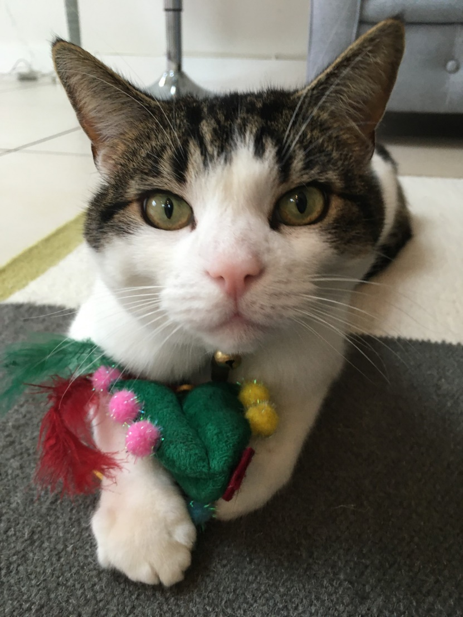
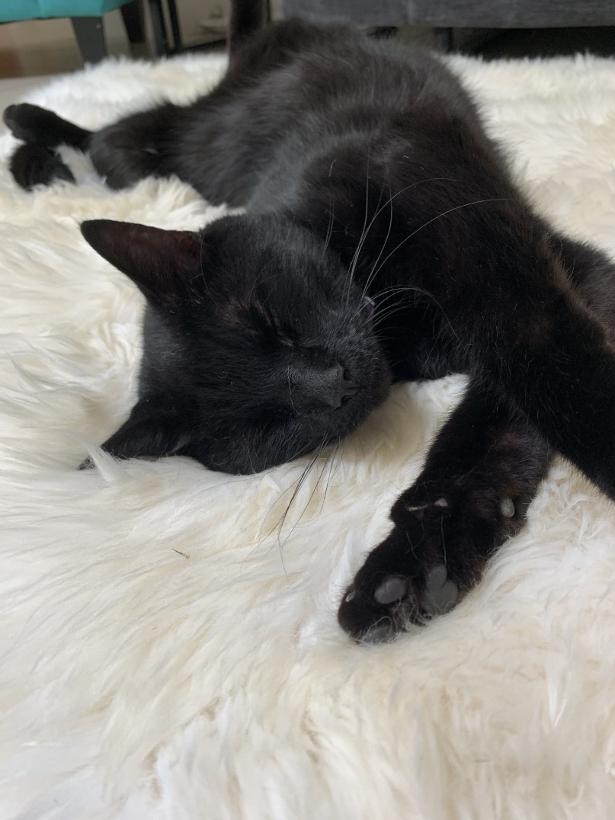
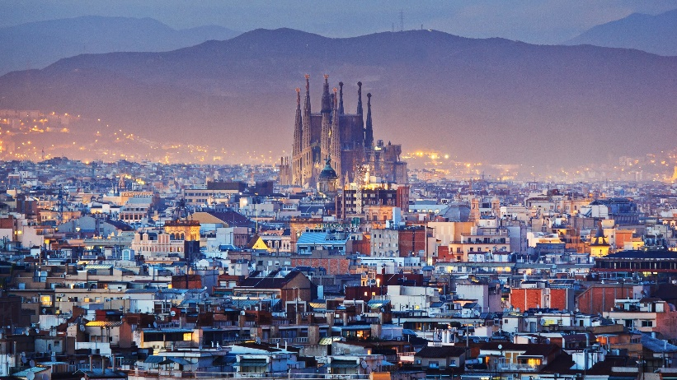

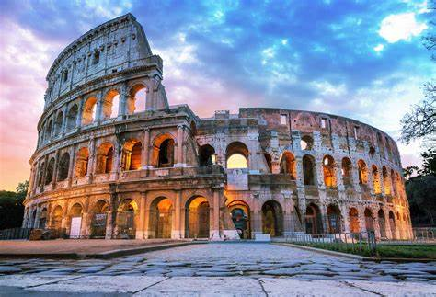

My (Heidi’s) Hobbies and Interests
Two cats and a dog
Used to play cricket and football
Enjoy tennis and running now
Favourite genre: comedies
Want to live abroad
Key takeaways:
Collaborative working
Importance of communication
Enjoy coding, but do not want to be purely a programmer

Slide 3
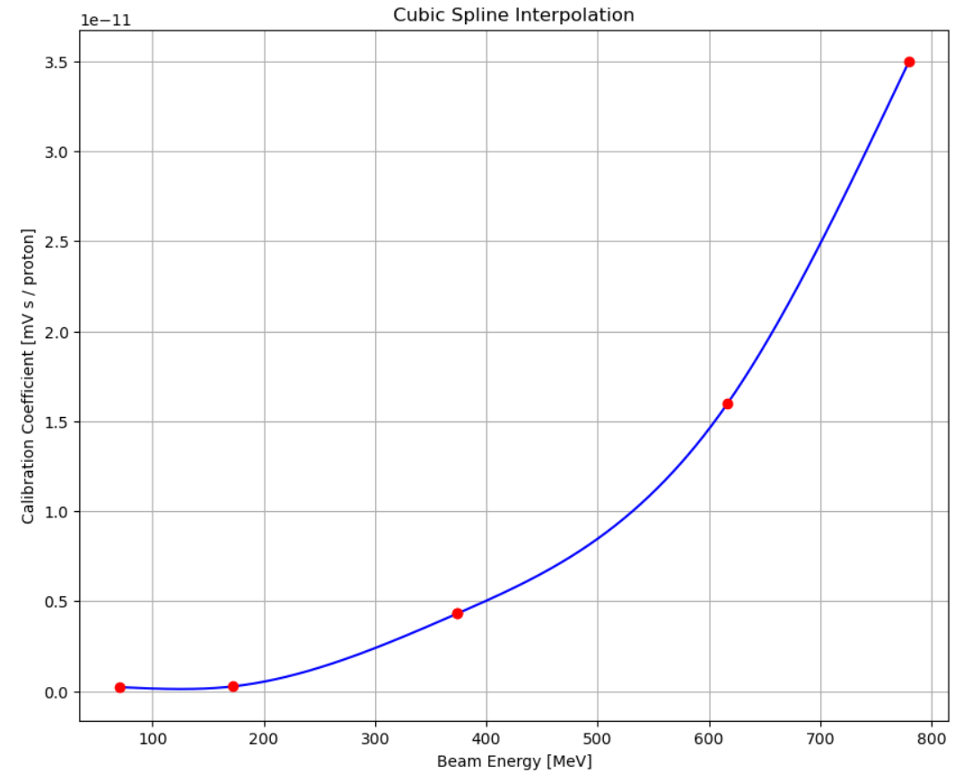
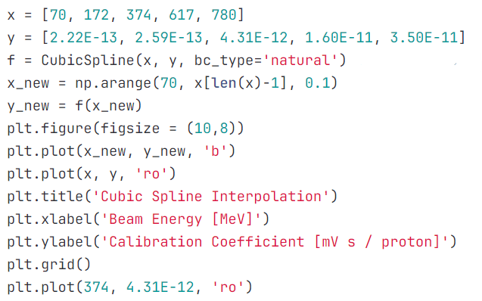
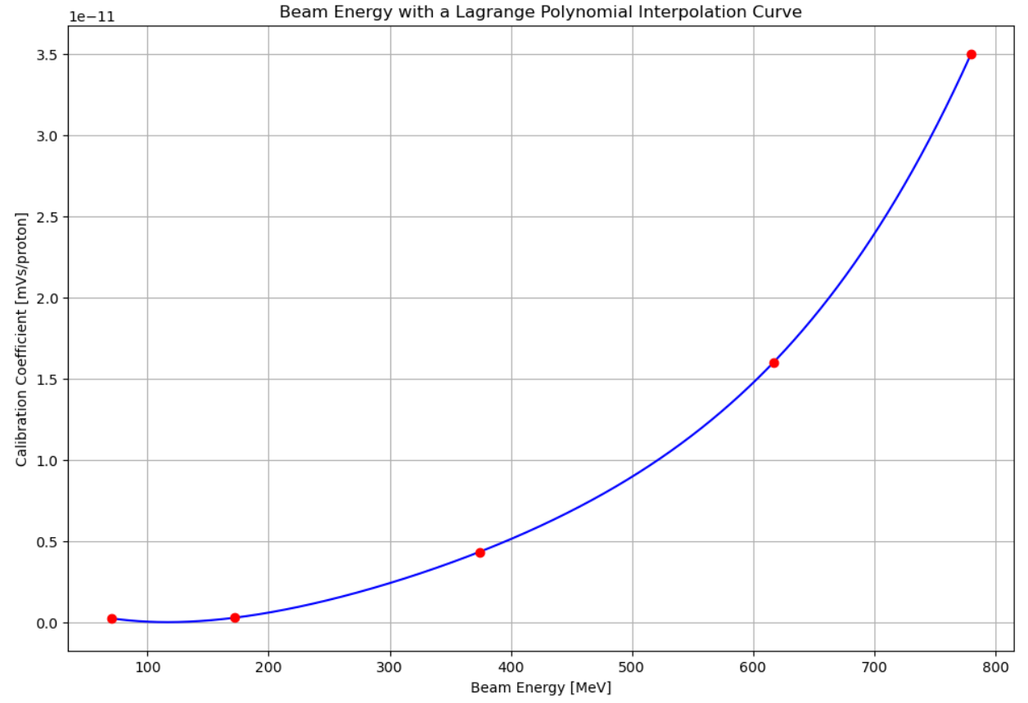
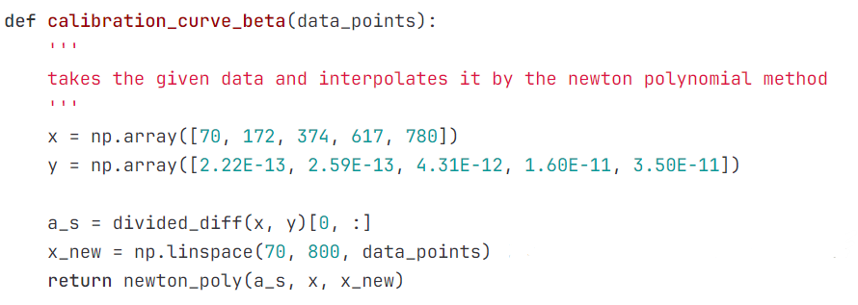
Stage 1 Projects: Group 1F: Energy Conversion With Interpolation
(With Toby and Henrique)
Researched interpolation methods
Created interpolated curves
Extracting calibration curve data
Matplotlib
Git
Notes:
New coding knowledge was overwhelming at first
Ability to use newfound knowledge in applied scenarios

Slide 4
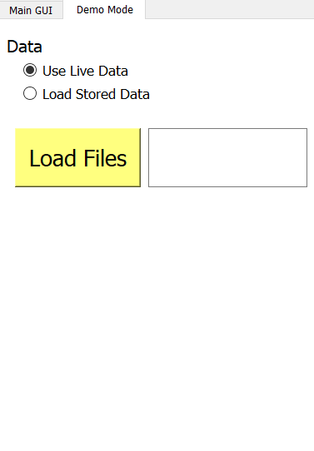
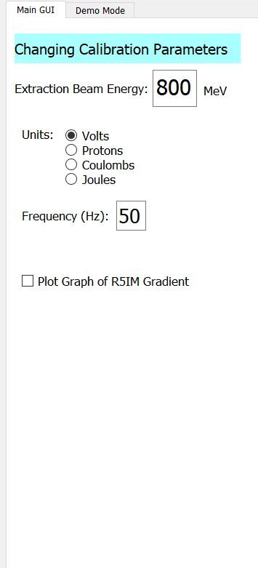
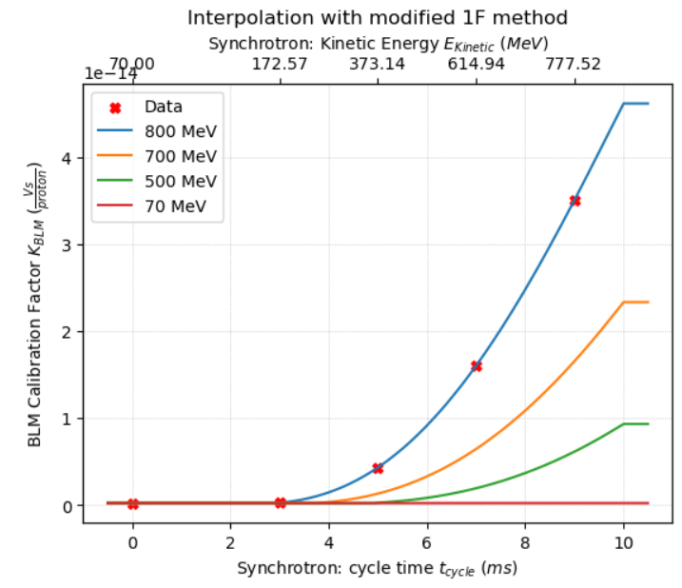
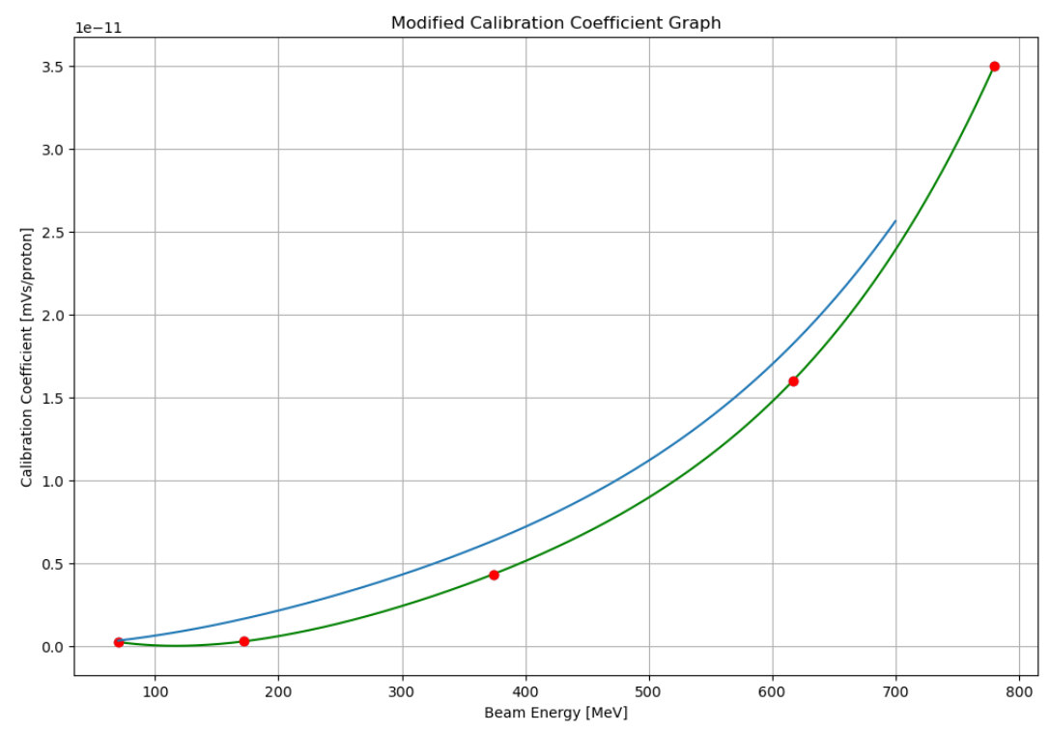
Stage 2 Projects: Synchrotron Loss Finder
Changing beam extraction energy
Difficulty with code
Designed GUI interface
Unit conversion
Enjoyed making a prototype which will be used by scientists
Live data on GUI
Final Graph
(with help from Haroon)
Initial Attempt

Slide 5
Acknowledgments
We are privileged to do a job that we love, and one that serves so many. In order to do big science we require vast teams and incredible people who support our work. We must always acknowledge those who contribute to our success.
Our cleaner Pamela sanitises every desk in the building, vacuums our biscuit crumbs, mops the floors, disposes of our cups and napkins, carries our refuse to the industrial bins, ensures we have clean toilets, and often moves furniture, every day before we arrive.
Our reception team have had to phone a grumpy physicist on every occasion that you forgot your badges, and often I’ve missed their calls so they’ve sorted you out anyway. That’s a lot of unnecessary hassle for them.
Our public engagement (PE) team have read ~ 700 wx applications, sifted and sorted your applications, so that we could select you individually. All other wx students have a desk wherever their supervisor can find space. The PE team have not only granted us their space for 2 weeks, but the use of their laptops. We have exceptionally been granted use of their personal kitchen.
Please delete the above message and keep it simple:
Public Engagement Team
Etc

Slide 6
GUI Demo
5 minutes max, show live data, demo mode, change some settings and show features

Slide 7
Thank you
Questions?

